Slide 1



Slide 2

01 Problem Statement 02 Solution 03 Use Case Diagram 04 The Main Actors
05 Functionalities
06 Scope Of the Project
07 ER diagram
08 The Team
CONTENTS

Slide 3

Problem Statement
Farmers are the most integral part of our society but they have to suffer a lot when it comes to getting authentic verified products for their farming
Whether it be seeds, other required nutrients for plants or even small tools they don’t have a platform where they can get these things easily with the comfort of their home

Slide 4

THE SOLUTION
To tackle this problem of the farmers we have created a platform where the farmers can find the useful farming supplies like SEEDS, FERTILIZERS, PESTICIDES, PLANTS, FLOWERS and TOOLS and the products will get delivered to there doorstep as soon as possible.
This platform is intended to support the farmers in making there farming experience easy and seamless

Slide 5

03
Use Case
Diagram

Slide 6
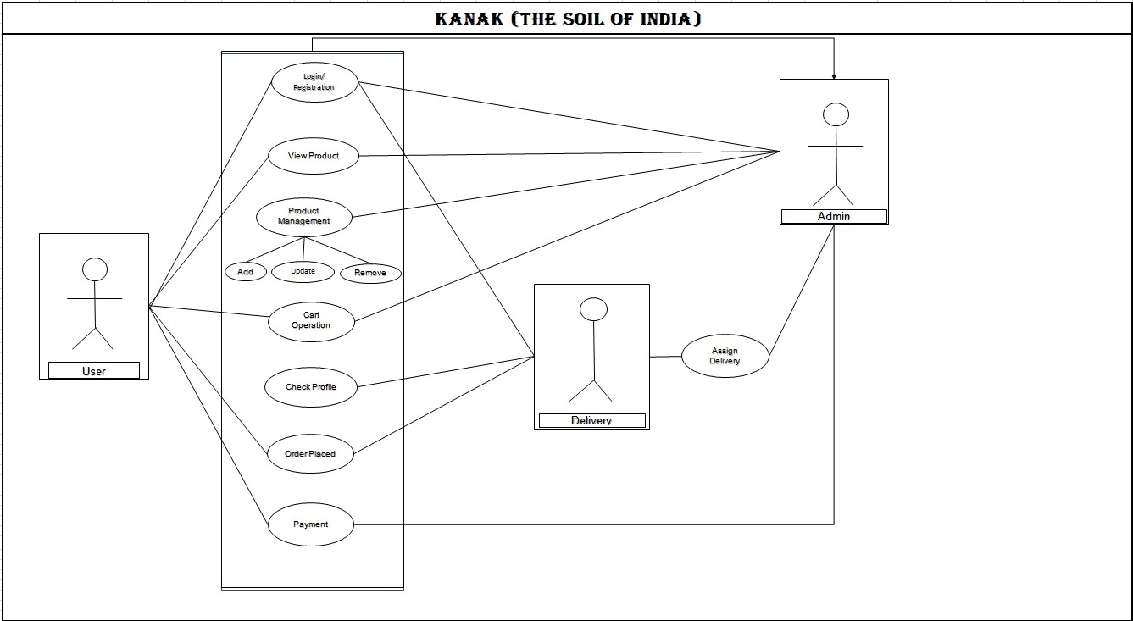

Slide 7

The Main
ACTORS
01 Users/Customers 02 Delivery Agents 03 Admins/Vendors

Slide 8
Customer Module:
The Customer Module is designed to cater to the needs of buyers looking for fresh and high-quality agricultural products. It provides a user-friendly interface where customers can.
Browse Products: Customers can search and browse a wide variety of agricultural products such as seeds, grains, pesticides, plants, flowers and farming tools. Product Details: Each product listing includes detailed information about the product, including price, product description.
Cart Management: Customers can add products to their shopping cart with respect to available stock of product. also customer can review their selections, and proceed to checkout. Order Placement: Customers can place orders for the selected products, specify quantities, and choose delivery preferences.
Payment: Secure payment options are provided for customers to complete transactions (Card Payment). Order Management: After the payment admin can assign the order to particular delivery person.
Delivery: Delivery person can see the completed, in processing and pending delivery. As per there availability delivery person can react to the particular delivery. Order Tracking: Customers can track the status of their orders, with the help of order ID.
05
Functionalities

Slide 9
Admin Module:
The Admin Module is designed to manage the overall functioning of the platform. It provides the admins ie the vendors various option by which they can fulfil the user requests and needs
Stock Management: The admins are responsible for managing the stock. They have the access to add stock.
Category Management: Admins can manage products based on the categories. They can also manage the categories.
Approve Orders: Admins can approve the items selected by the customers according to the availability.
Delivery Assigning: Admins will assign a delivery executive for each order according to an unique order id. Order Tracking: The admins have an access to the order tracking report that is updated by the delivery agents
05
Functionalities

Slide 10
Delivery Module:
Order Assignment: Delivery person can see the available delivery new orders assigned to them.
Route Optimization: The platform provides optimized delivery routes to ensure efficient delivery of multiple orders. Real-time Updates: Delivery personnel can update the order status in real-time, allowing customers to track their orders.
Communication: The module facilitates communication between delivery personnel and customers for updates about delivery. Confirmation: Delivery personnel mark orders as delivered after successful delivery.
05
Functionalities

Slide 11

SCOPE Of the PROJECT
The scope of the project to create a platform that provides farming supplies and tools to farmers is quite extensive and can be broken down into various components:
Providing a diverse range of products such as seeds, fertilizers, pesticides, plants, flowers, and tools.
Developing an intuitive and user-friendly website or app interface.
Implementing a robust search and filtering system for easy product discovery
Designing a seamless shopping cart and checkout process.

Slide 12
06
E-R Diagram

Slide 13
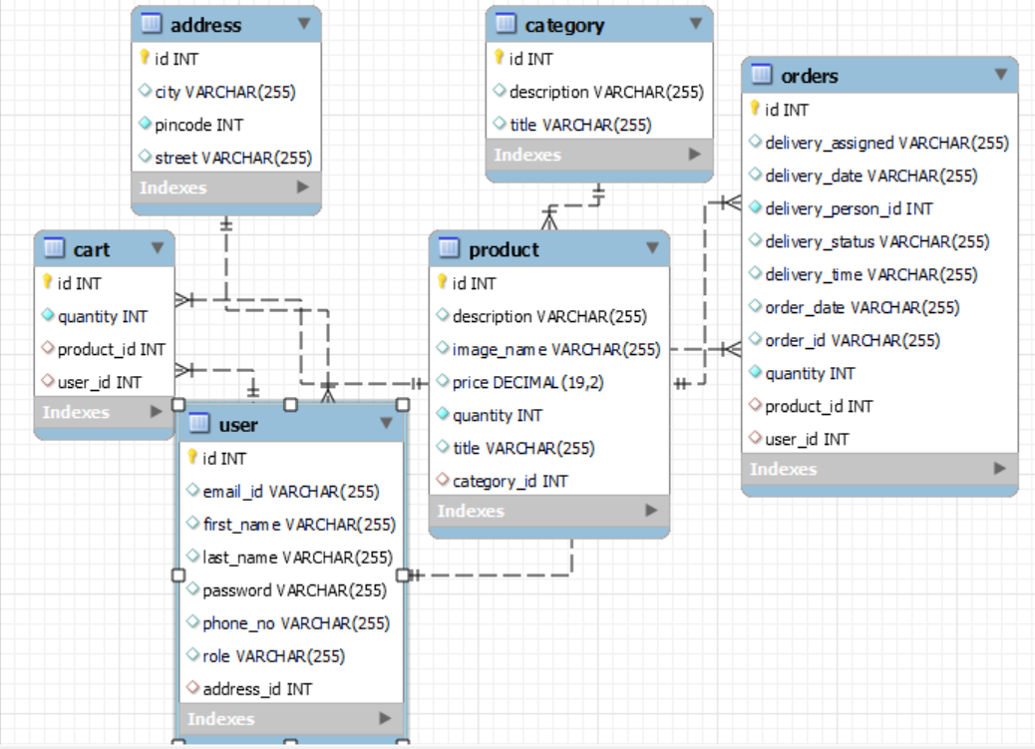

Slide 14

The Team
1. Prashant Patel
230345920068
2. Akshay kapse (Team Leader)
230345920011
3. Akshay Tiwari
230345920012
4. Pratiyush Pathak
230345920071

Slide 15
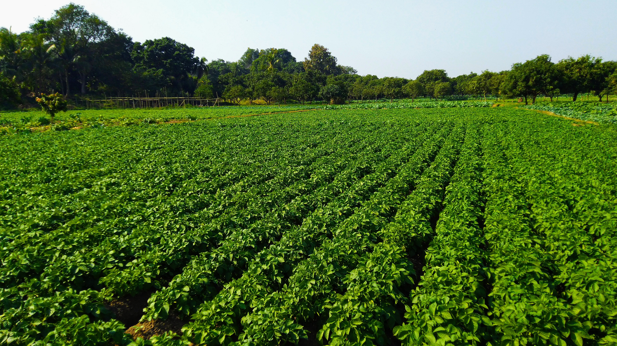
THANK YOU

